Slide 1
SAS® Training
Basic SAS Procedures

Slide 2
Topics covered…
SET statement
Basic PROC Print
Basic PROC Contents
SORT
Conditional logic
If, Then, Else
Subsetting datasets
IF and WHERE

Slide 3
SET Statement

Slide 4
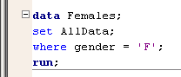
SET statement
After you’ve brought your data into a SAS dataset, most of your DATA steps will look like this:
Creates a new dataset called “Females”
Uses previous dataset “AllData” as the basis of the new dataset
Applies these modifications to the new dataset

Slide 5
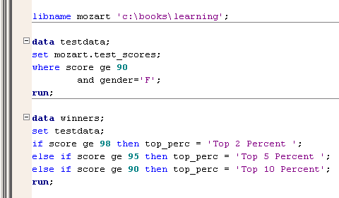
SET statement
The SET statement is similar to an INPUT statement
Except instead of a raw data file, you are reading observations from a SAS dataset
Can read in temporary or permanent SAS datasets

Slide 6
PROC Print

Slide 7
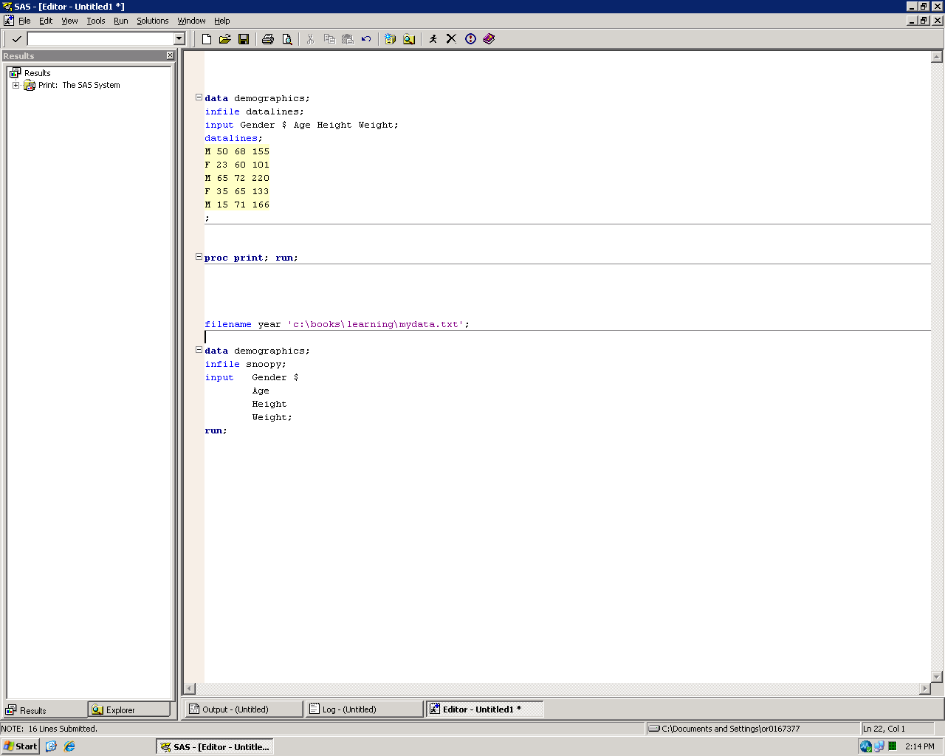
PROC Print
PROC Print can be used to list the data in a SAS dataset

Slide 8
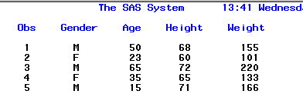
PROC Print
Results of PROC Print of “Demographics”

Slide 9

PROC Print
Many options to control output of PROC Print
noobs – Suppresses “OBS” column in output
(obs=2) – Only prints the first two observations
Can put in any number: 1 through N
Must be placed in parentheses after data= option
var statement – Only prints listed variables

Slide 10
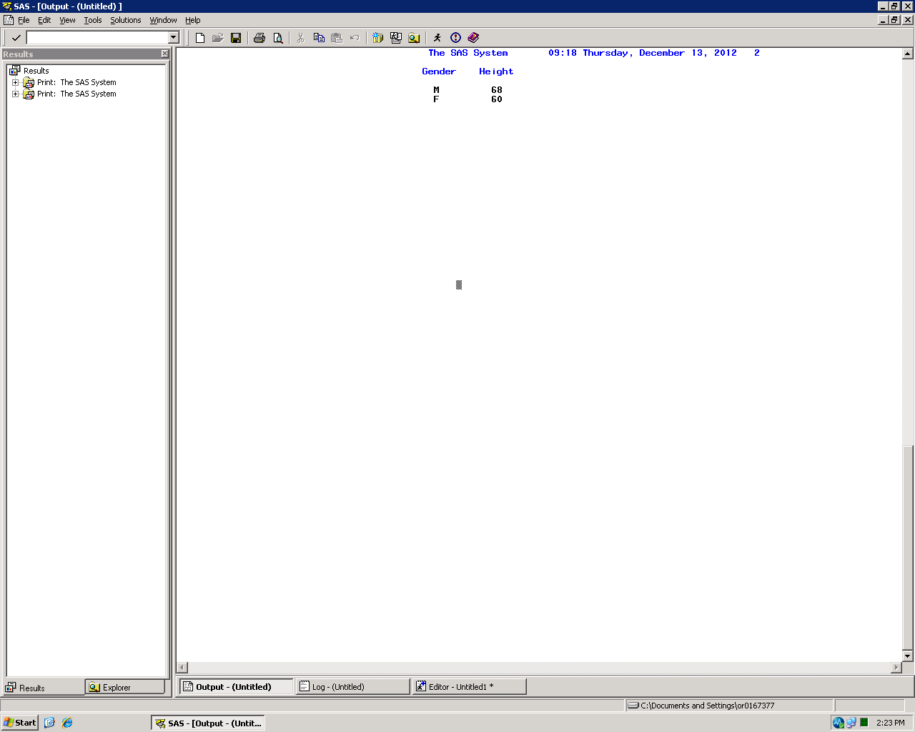
PROC Print
We’ll discuss other PROC Print options in later chapters

Slide 11
PROC Contents

Slide 12
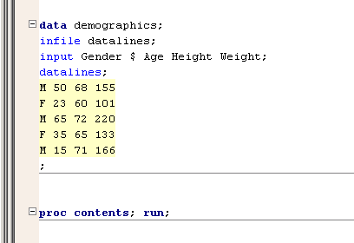
PROC Contents
PROC Contents can be used to display the metadata (descriptor portion) of the SAS dataset

Slide 13
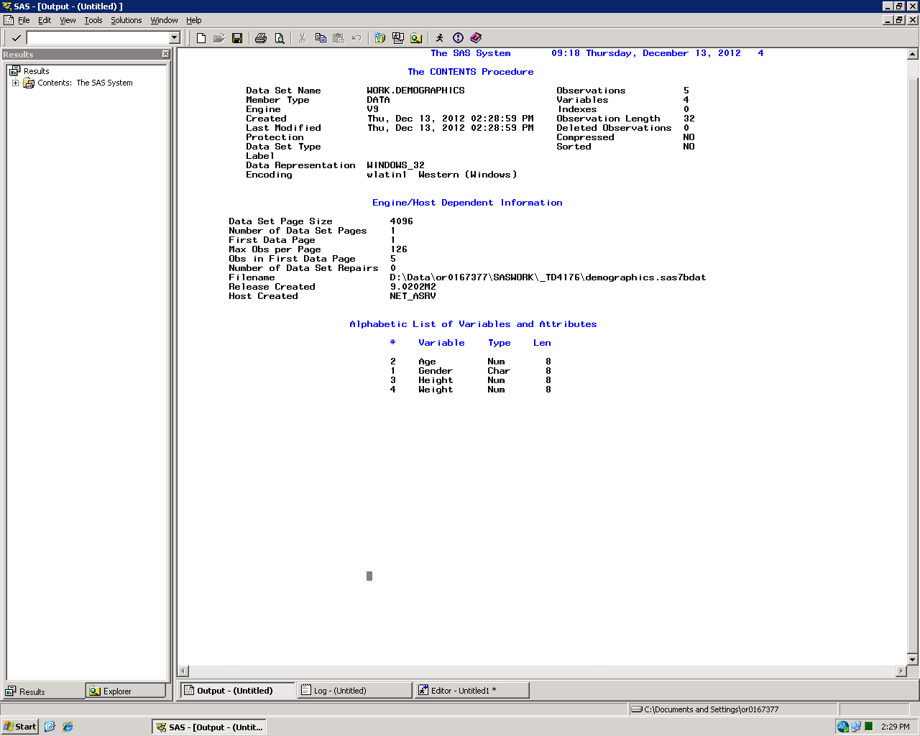
PROC Contents
Results of PROC Contents of “Demographics”

Slide 14
PROC Contents
Dataset name
Number of observations and variables
File name
Variable list

Slide 15
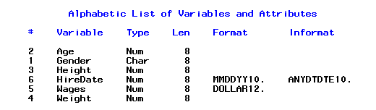
PROC Contents variable list
# - Variable number (varnum)
Variable – Name of variable
Type – Numeric or Character
Len – Variable length
Format – How the data is displayed
Informat – How the data was read by SAS

Slide 16
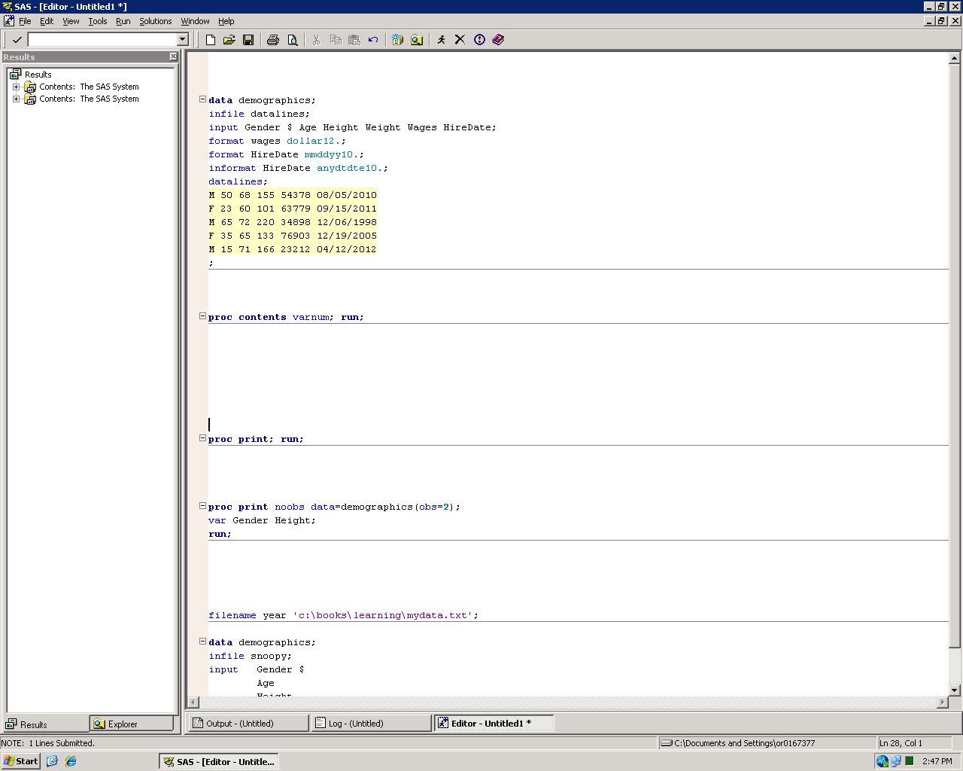
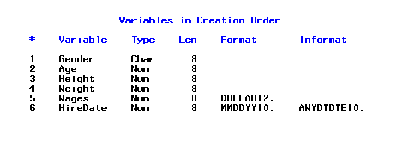
PROC Contents variable list
Variables listed in alphabetical order by default
Uppercase alphabetized before lowercase (e.g., “ZZTOP” would be alphabetized before “aerosmith”)
Use the varnum option to list variables in order they were created in

Slide 17
PROC SORT

Slide 18
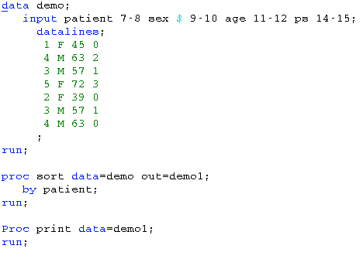
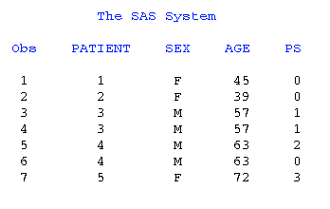
SORT
The SORT procedure sorts observations in a SAS data set by one or more character or numeric variables, either replacing the original data set or creating a new, sorted data set.

Slide 19

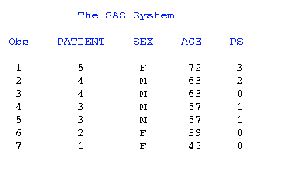
SORT – Descending Option
By default SAS sorts the data with the BY variables in ascending order. If we want the data to be sorted by the BY variables in descending order then we can use the descending option in SAS.
SAS Output

Slide 20
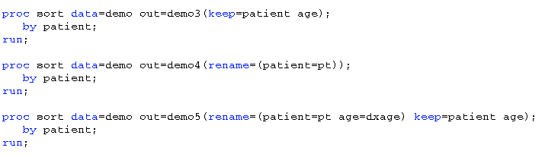
DROP=, KEEP=, AND RENAME= OPTIONS
You can use the DROP=, KEEP=, and RENAME= options within the SORT procedure just as you can within a DATA step. Here are some examples using these options along with how the output data sets look:

Slide 21
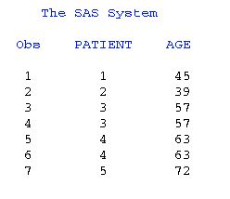
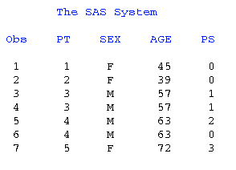
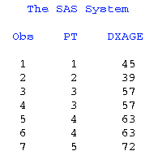
Examples:
DEMO3 dataset: DEMO4 Dataset:
DEMO5 Dataset:
Notes:
There are a few of things to keep in mind when using these options. First, if you use the RENAME= option, SAS
changes the name of the variable in that procedure. Second, if you use RENAME= with either the DROP= or the
KEEP= options, the DROP= and the KEEP= options are applied before RENAME=. Thus, use the “old name” in the
DROP= and KEEP= options. The order in which you place the RENAME=, DROP=, and KEEP= options does not
matter and does not change process order. In regard to using parentheses, a list of multiple variables to rename must
be enclosed in parentheses, renaming just one variable does not, and the KEEP= variables should not be enclosed in
parentheses. Another thing to remember is that you cannot drop and rename the same variable in the same
statement.

Slide 22
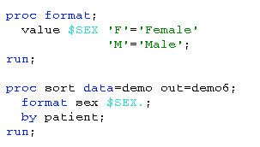
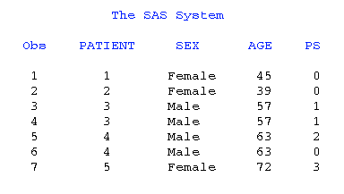
FORMAT AND LABEL STATEMENTS
Other statements that are the same in the SORT procedure as in a DATA step are the FORMAT and LABEL statements. You can apply a variable format or create variable labels within PROC SORT. Example:
Notes:
In this example, the format $SEX was created in the FORMAT procedure. This format was then applied to the
variable SEX in a PROC SORT statement. Now, in the output data set, instead of ‘F’ and ‘M’, you see the formatted
values ‘Female’ and ‘Male’. Note that the FORMAT statement does not permanently alter the variables in the input
data set

Slide 23
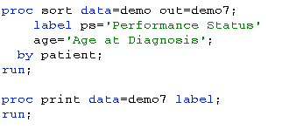
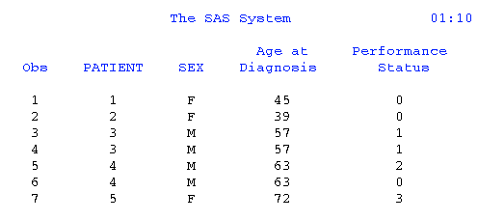
Example Using Labels
NOTE: By using the PRINT procedure with the label option following the PROC SORT statement, you can see the labels created for the variables PS and AGE. Like the FORMAT statement, the LABEL statement does not permanently alter the variables in the input data set

Slide 24


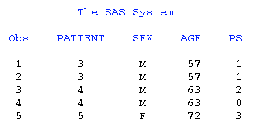
WHERE= OPTION OR WHERE STATEMENT
SORT procedure allows you to subset your data by using the WHERE= option or WHERE STATEMENT.
Example using the WHERE= option:
Example using WHERE statement:
Notes:
Both of these statements work similarly by selecting observations that meet the condition specified in the WHERE expression before SAS brings them into the PROC SORT for processing. This may improve the efficiency of your SAS programs because SAS is not required to read all observations from the input data
set.

Slide 25
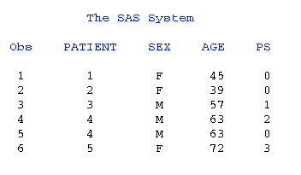
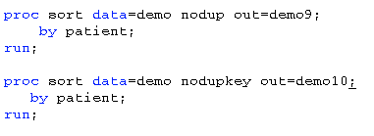
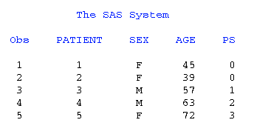
NODUPRECS AND NODUPKEY OPTIONS
The NODUPRECS (or NODUP) and NODUPKEY options work similarly in that they both can eliminate unwanted observations, but NODUP compares all the variables in your data set while NODUPKEY compares just the BY variables.
Notes:
if you use the NODUP option, PROC SORT compares all variable values for each observation to those for the previous observation that
was written to the output data set. If an exact match is found, the observation is not written to the output data set. If you specify the
NODUPKEY option, PROC SORT compares all BY variable values for each observation to those for the previous observation written to the
output data set. If an exact match using the BY variable values is found, the observation is not written to the output data set.
In this example, using NODUPKEY instead of NODUP may not be the better option to use because by using NODUPKEY, you eliminate the
second observation for patient 04 even though there was a different performance score for this observation. This may be important
information that needs to be kept in the data set.

Slide 26
Conditional Logic
If, Then, Else

Slide 27
If, Then, Else
IF <condition> THEN <X>;
ELSE <Y>;
If Score >= 7 Then Response = 'Passing Grade';
Else Grade = Failing Grade';
Student | Score | Grade
Jane | 75 | Passing Grade
Dave | 56 | Failing Grade
Jack | 90 | Passing Grade
Sue | 68 | Failing Grade

Slide 28
If, Then, Else
IF <condition> THEN <X>;
ELSE <Y>;
If Score >= 70 Then Grade = 'Passing Grade';
Else Grade = 'Failing Grade';
Assignment statement
Used to create new variables
Student | Score | Grade
Jane | 75 | Passing Grade
Dave | 56 | Failing Grade
Jack | 90 | Passing Grade
Sue | 68 | Failing Grade

Slide 29
If, Then, Else
IF <condition> THEN <X>;
ELSE IF <condition2> THEN <Y>;
ELSE <Z>;
If Score >= 7 Then Grade = 'Passing Grade';
Else If 60 <= Score <= 69 Then Grade = 'Incomplete';
Else Grade = 'Failing Grade';
Student | Score | Grade
Jane | 75 | Passing Grade
Dave | 56 | Failing Grade
Jack | 90 | Passing Grade
Sue | 68 | Incomplete

Slide 30
If, Then, Else
When using ELSE IF:
Processes IF-THEN conditions until first true statement is met, then it moves on to the next observation
Once a condition is met, the observation is not reevaluated

Slide 31
If, Then, Else
If Score >= 70 Then Grade = 'Passing Grade';
Else If 60 <= Score <= 69 Then Grade = 'Incomplete';
Else Grade = 'Failing Grade';
Student | Score | Grade
Jane | 75 | Passing Grade
Dave | 56 | Failing Grade
Jack | 90 | Passing Grade
Sue | 68 | Incomplete

Slide 32
If, Then, Else
If Score >= 90 Then Grade = 'A';
If Score >= 80 Then Grade = 'B';
If Score >= 70 Then Grade = 'C';
If Score >= 60 Then Grade = 'D';
If Score < 60 Then Grade = 'F';
Student | Score | Grade
Jane | 75 | D
Dave | 56 | F
Jack | 90 | D
Sue | 68 | D

Slide 33
If, Then, Else
If Score >= 90 Then Grade = 'A';
If Score >= 80 Then Grade = 'B';
If Score >= 70 Then Grade = 'C';
If Score >= 60 Then Grade = 'D';
If Score < 60 Then Grade = 'F';
Common mistake:
Not using
ELSE IF
Each subsequent IF re-evaluated every observation
Student | Score | Grade
Jane | 75 | D
Dave | 56 | F
Jack | 90 | D
Sue | 68 | D

Slide 34
If, Then, Else
If Score >= 90 Then Grade = 'A';
If Score >= 80 Then Grade = 'B';
If Score >= 70 Then Grade = 'C';
If Score >= 60 Then Grade = 'D';
If Score < 60 Then Grade = 'F';
Student | Score | Grade
Jack | 90
A
B
C
D

Slide 35
If, Then, Else
If Score >= 90 Then Grade = 'A';
ELSE If Score >= 80 Then Grade = 'B';
ELSE If Score >= 70 Then Grade = 'C';
ELSE If Score >= 60 Then Grade = 'D';
ELSE If Score < 60 Then Grade = 'F';
Student | Score | Grade
Jack | 90
A

Slide 36
If, Then, Else
If Score >= 90 Then Grade = 'A';
ELSE If Score >= 80 Then Grade = 'B';
ELSE If Score >= 70 Then Grade = 'C';
ELSE If Score >= 60 Then Grade = 'D';
ELSE If Score < 60 Then Grade = 'F';
Student | Score | Grade
Jane | 75 | C
Dave | 56 | F
Jack | 90 | A
Sue | 68 | D

Slide 37
Operators

Slide 38
Arithmetic operators
Arithmetic | Symbol | Example
Addition | + | Xplus = 4+2;
Subtraction | – | Xminus = 4-2;
Multiplication | * | Xmult = 4*2;
Division | / | Xdiv = 4/2;
Exponents | ** | Xexp = 4**2;
Negative numbers | – | Xneg = -2;

Slide 39
Comparison operators
Logical comparison | Mnemonic | Symbol
Equal to | EQ | =
Not equal to | NE | ^= or ~=
Less than | LT | <
Less than or equal to | LE | <=
Greater than | GT | >
Greater than or equal to | GE | >=
Equal to one in a list | IN
Not equal to any in a list | NOT IN
Note: <> also used for not equal to, but only in PROC SQL

Slide 40
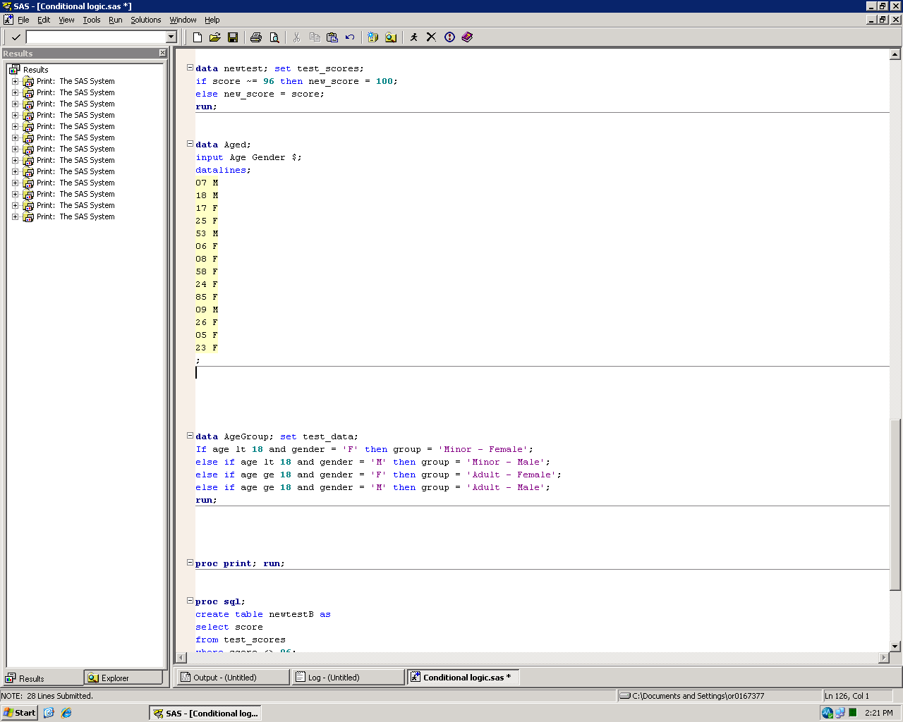
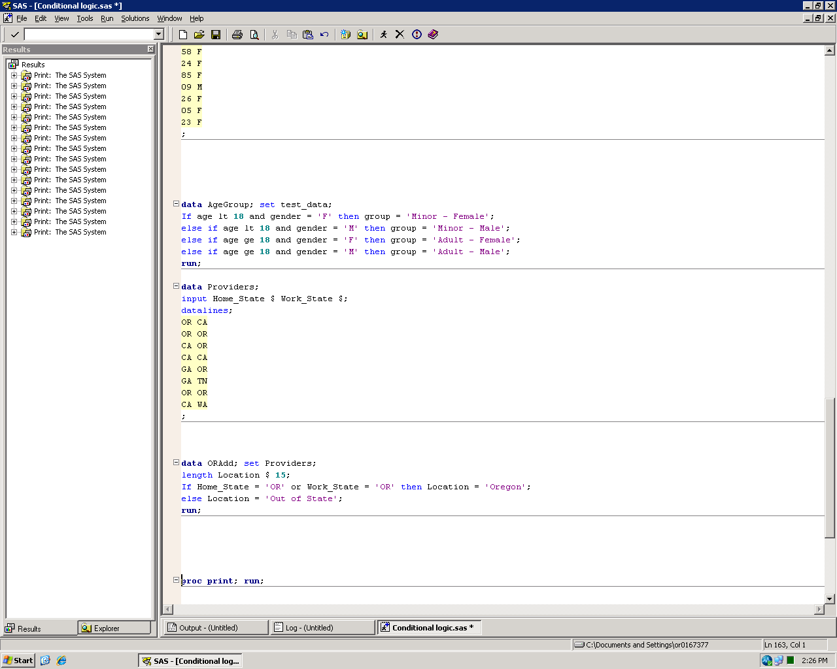
Logical operators
Boolean operator
And
Or
Not

Slide 41
Logical operators
POP QUIZ:
If A or B and C;
is the same as…
If (A or B) and C;
If A or (B and C);

Slide 42
Logical operators
POP QUIZ:
If A or B and C;
is the same as…
If (A or B) and C;
If A or (B and C);

Slide 43
Order of operations
Arithmetic operators
Comparison operators (<, >, =, LIKE, etc.)
Logical operators
NOT
AND
OR
Use parentheses to control the order of operations

Slide 44
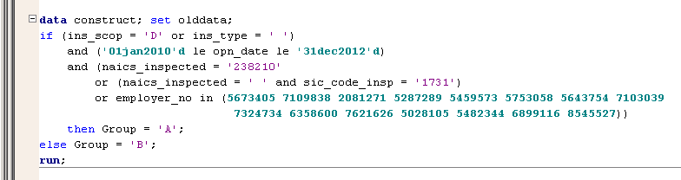
If, Then, Else
Logical conditions can be as complicated as you need them to be
Just make sure your order of operations is correct

Slide 45
Subsetting Datasets
Using IF and Where

Slide 46
Subsetting datasets
Can use IF or WHERE statements to only include observations you need
Both IF and WHERE statements can be used within DATA step if using SET statement to read in SAS data
IF statement must be used within DATA step if using INPUT statement to read raw data
WHERE statement must be used within PROC step

Slide 47
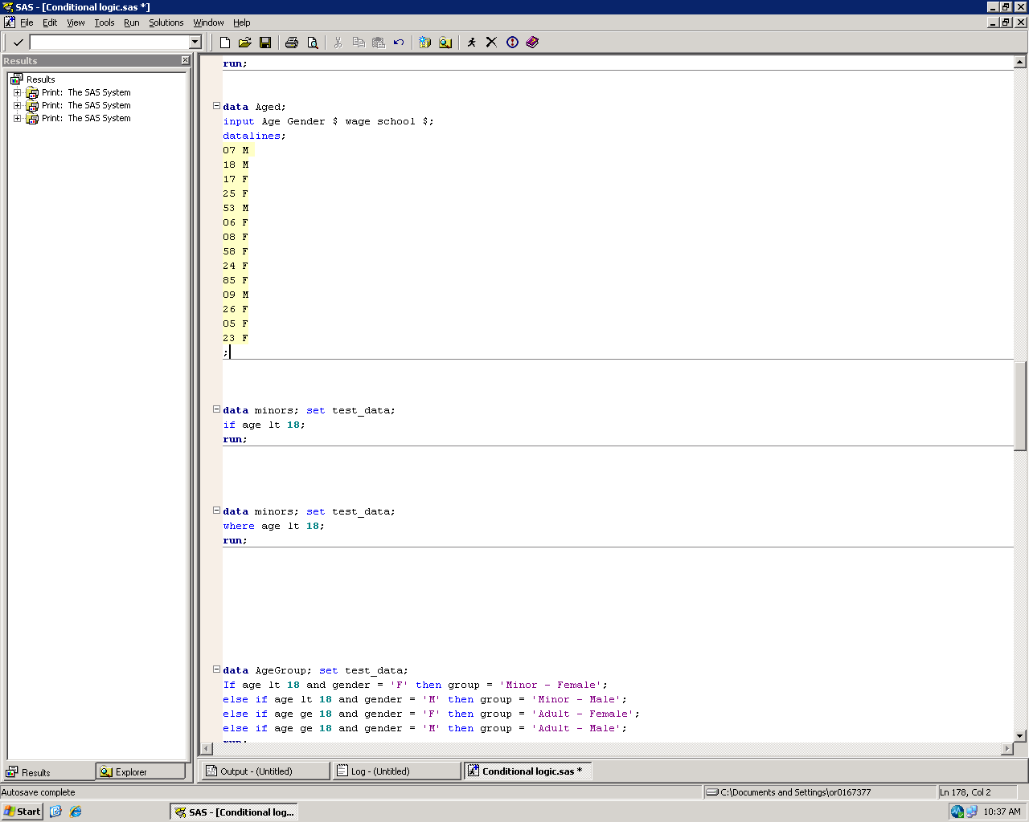
Subsetting datasets
Can use either IF or WHERE in a DATA step with SET statement
In both examples “Minors” dataset will only include observations where age is less than 18

Slide 48
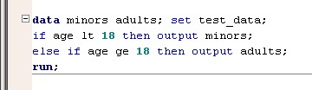
Subsetting datasets
Think of if age lt 18; as short for if age lt 18 then output;
Can output to multiple datasets using IF/THEN logic

Slide 49
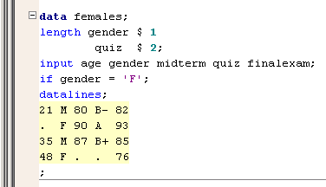
Subsetting IF
Use IF in the DATA step to bring in only the selected observations when using an INPUT statement
“Females” dataset will only include observations where gender = ‘F’

Slide 50
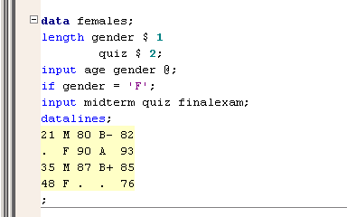
Subsetting IF
To improve efficiency, read the value of gender before using it to subset the data
Must use a trailing @ sign
(See chapter 21, section 11)

Slide 51
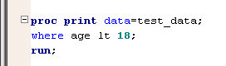
WHERE statement
Use a WHERE statement in a PROC step to only include selected observations
“Test_data” dataset still includes all observations
Only observations where age is less than 18 will be included in the calculations and output of the procedure

Slide 52
WHERE statement
WHERE statement allows for additional operators
Operator | Description | Example | Matches
IS MISSING | Matches a missing value | where gender is missing; | A missing character value
IS NULL | Equivalent to IS MISSING | where age is null; | A missing numeric value
BETWEEN AND | An inclusive range | where age between 20 and 40; | All values between 20 and 40, including 20 and 40
CONTAINS | Matches a substring | where name contains 'MAC'; | MACON, IMMACULATE
LIKE | Matching with wildcards | where name like 'R_N%'; | RON, RONALD, RUN, RUNNING
=* | Phonetic matching | where name =* 'NICK'; | NICK, NACK, NIKKI

